Slide 1
Cloud Core - Security, and Compliance
Ben Stegink

Slide 2
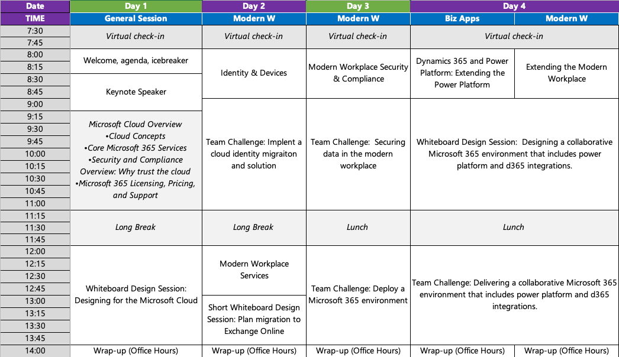

Slide 3

Day Three Rundown
Timeframe | Activity | Engagement
7:30 – 8:00 | Welcome / Check in
8:00 – 9:00 | Security, and Compliance | Interactive Discussion | Interactive Discussion
9:00 – 9:15 | Break
9:15 – 11:00 | Design a data protection plan | Hands On: Group Work
11:00 – 12:00 | Lunch
12:00 – 2:00 | Deploy a Microsoft 365 environment | Hands On: Group Work
2:00 | Wrap Up the Day

Slide 4


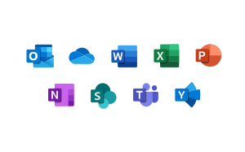
Where does security and compliance matter?
Devices
Services & Apps
Data

Slide 5
Office 365 E5 Trial

Slide 6
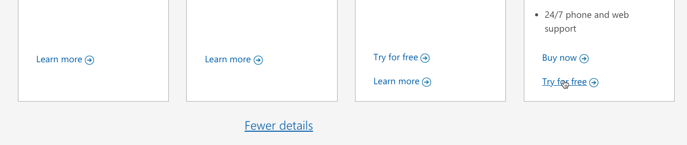
Office 365 E5 Trial
https://products.office.com/en-us/business/compare-more-office-365-for-business-plans
Try for Free

Slide 7
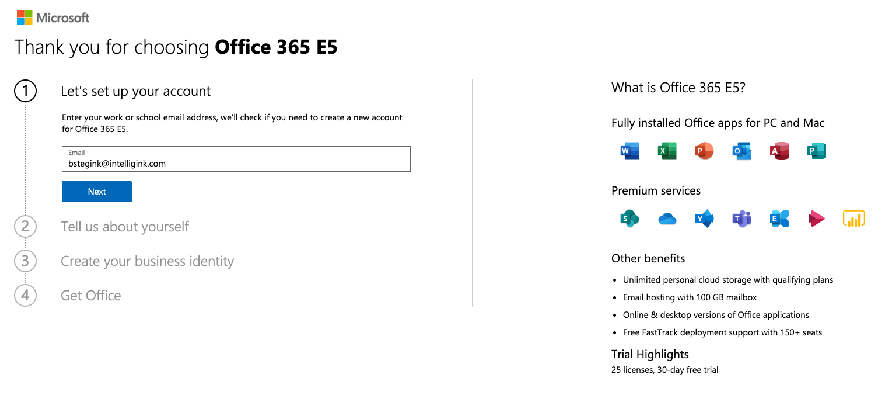
Create a trial step 1

Slide 8
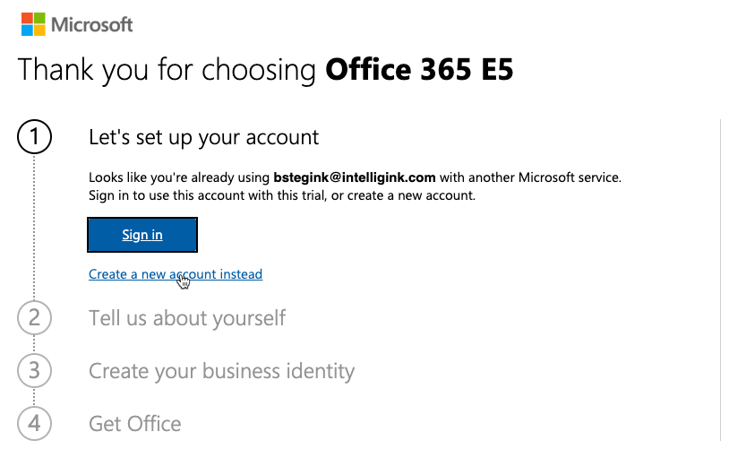
Create a trial step 2

Slide 9
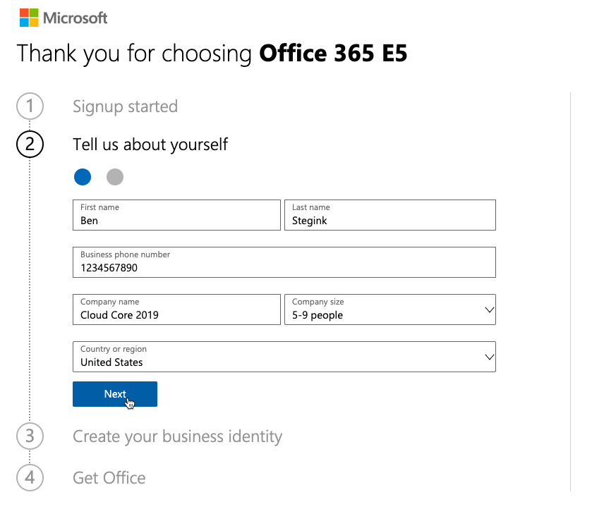
Create a trial step 3

Slide 10
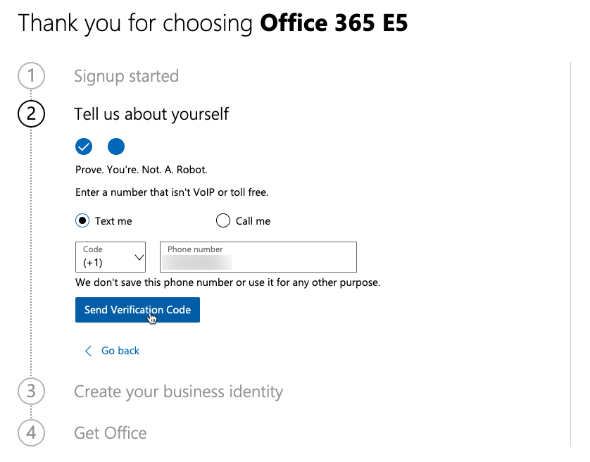
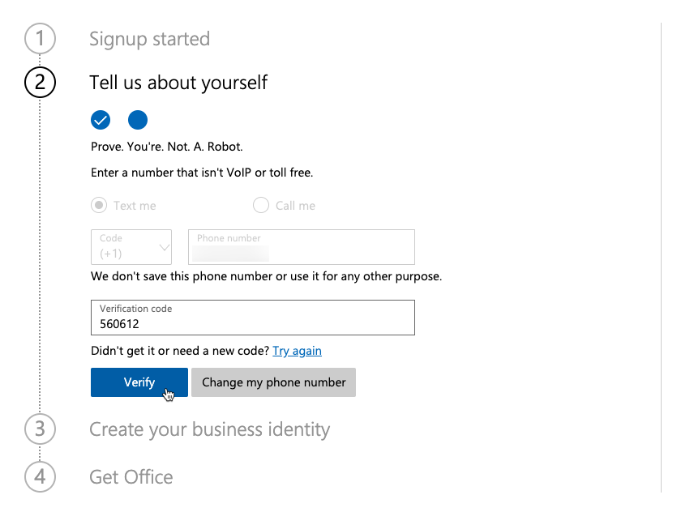
Create a trial step 4

Slide 11
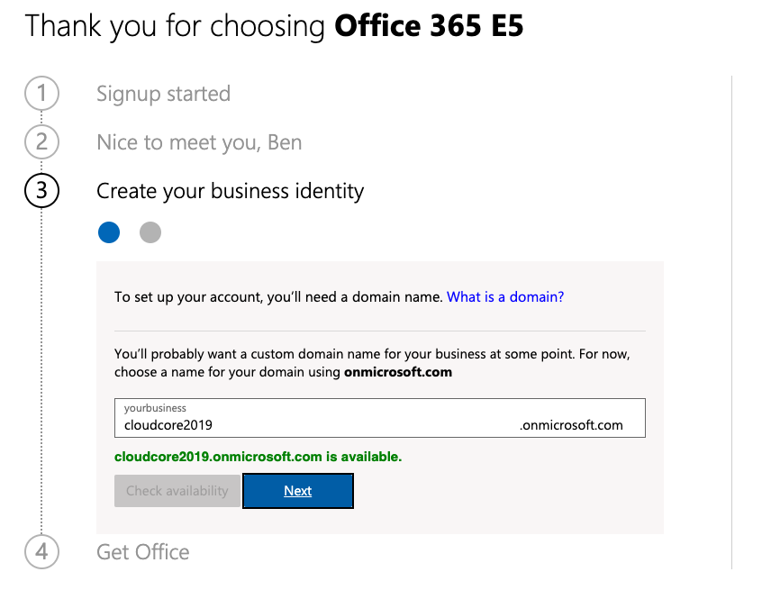
Create a trial step 5

Slide 12
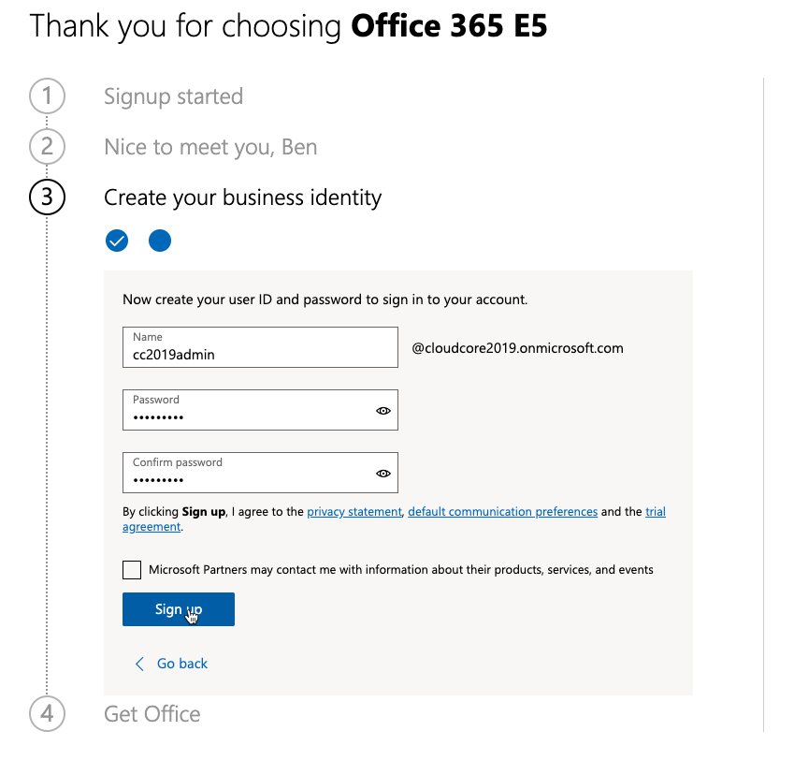
Create a trial step 6

Slide 13
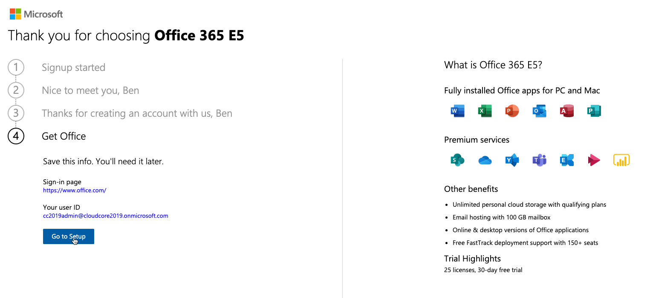
Create a trial step 7

Slide 14
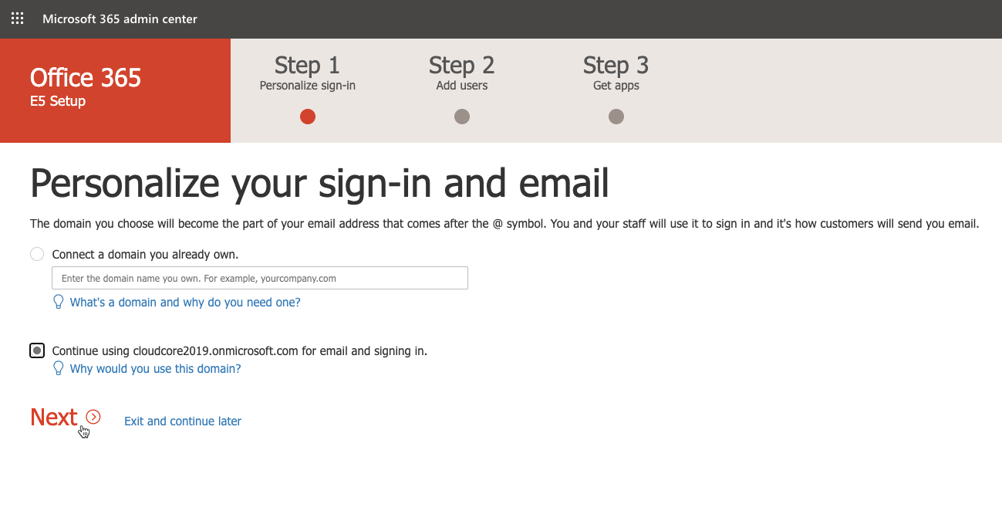
Create a trial step 8

Slide 15
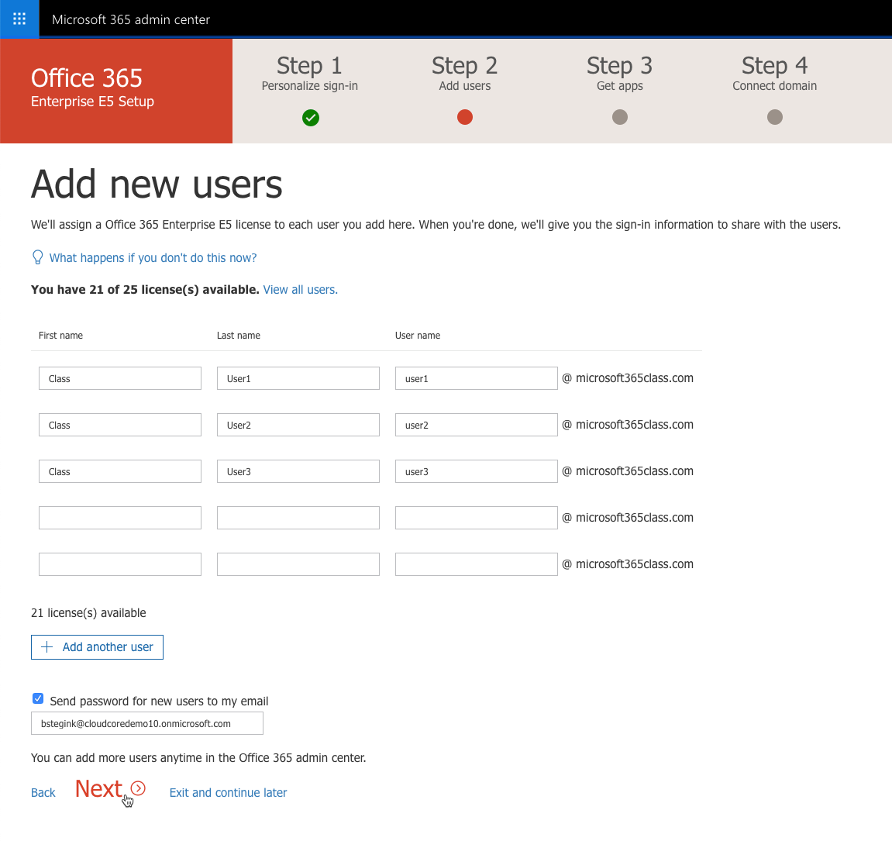
Create a trial step 9

Slide 16
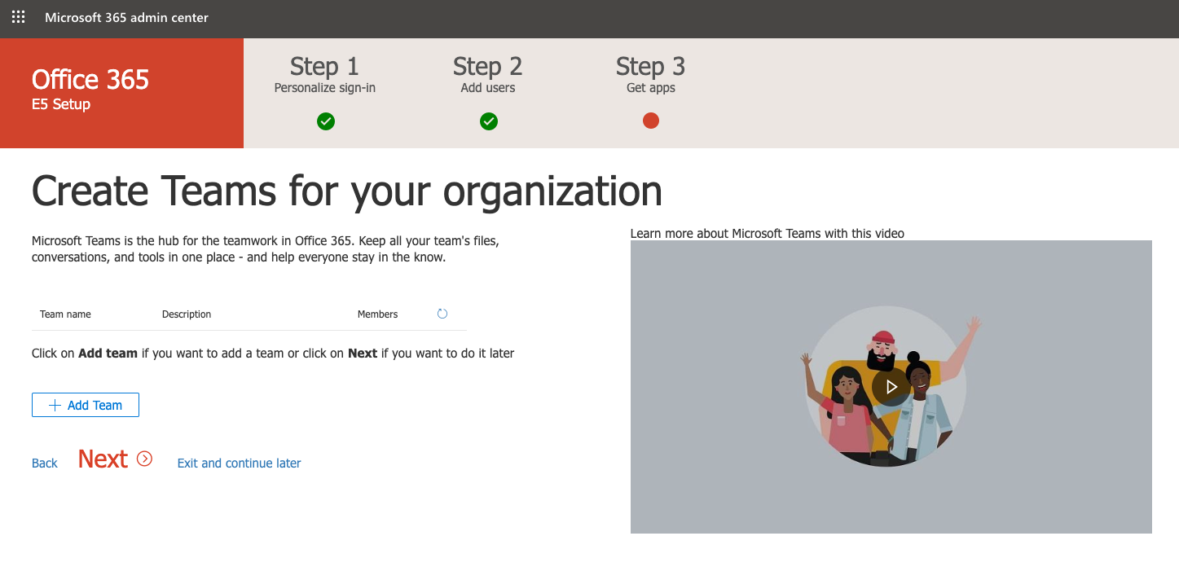
Create a trial step 10

Slide 17
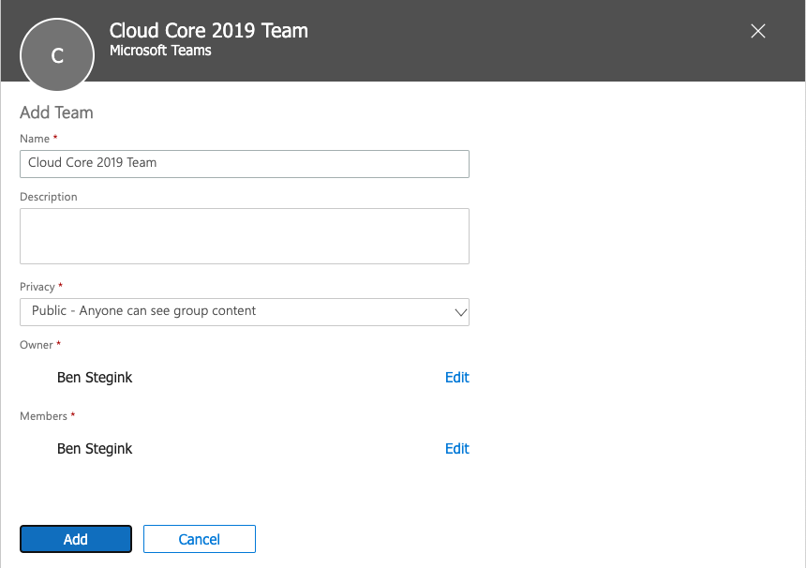
Create a trial step 10

Slide 18
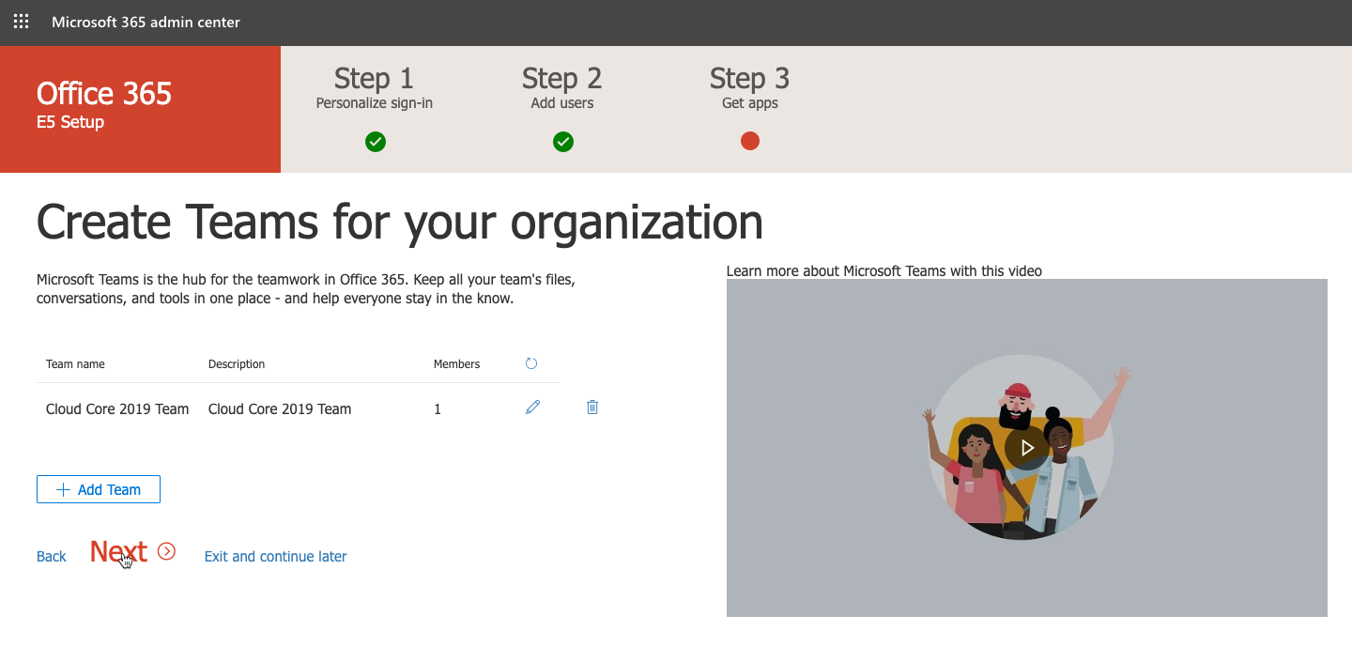
Create a trial step 10

Slide 19
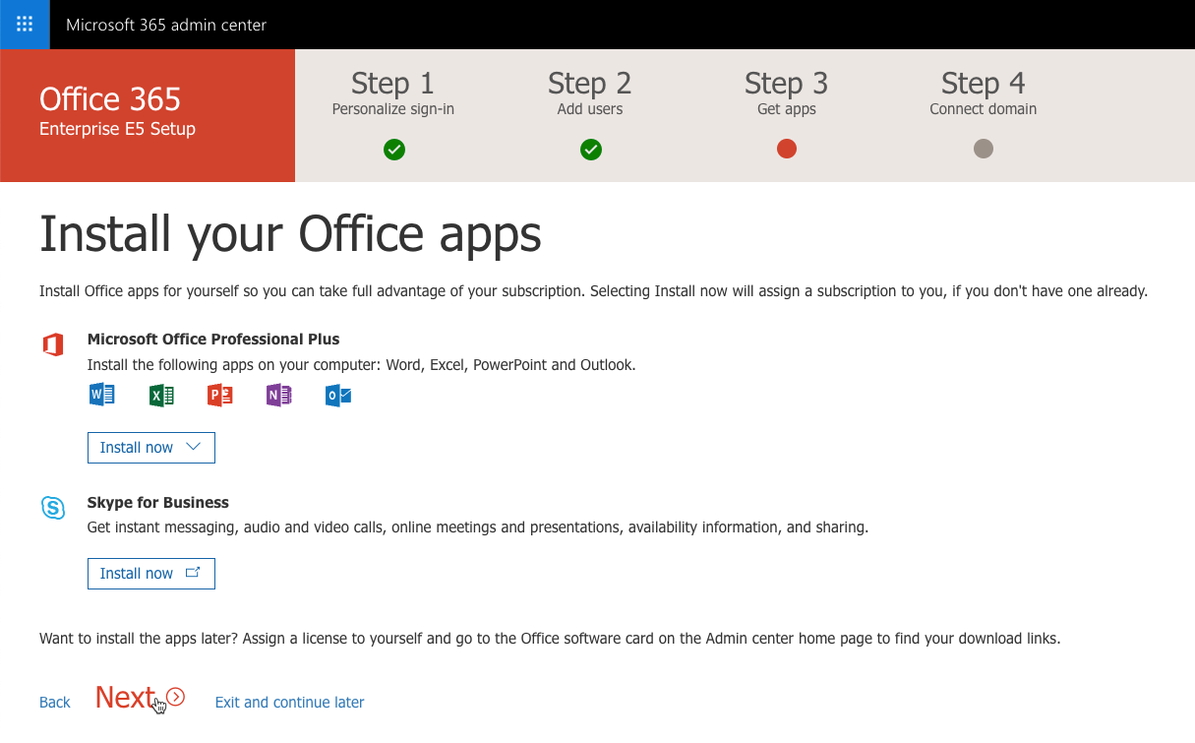
Create a trial step 11

Slide 20
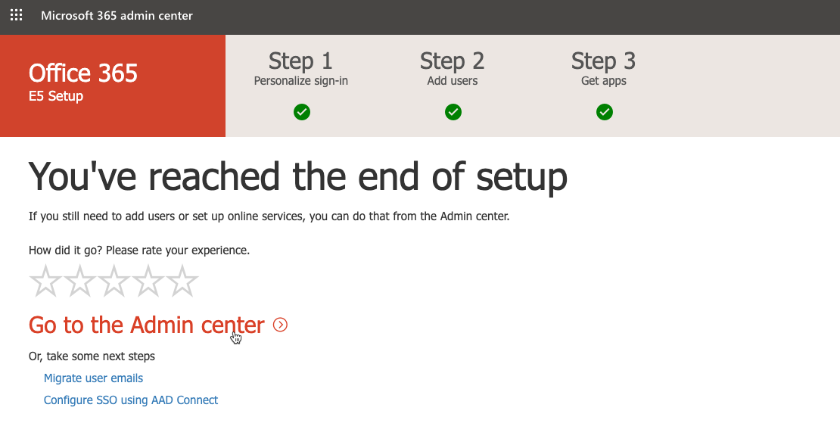
Create a trial step 11

Slide 21
EMS E5 Trial

Slide 22
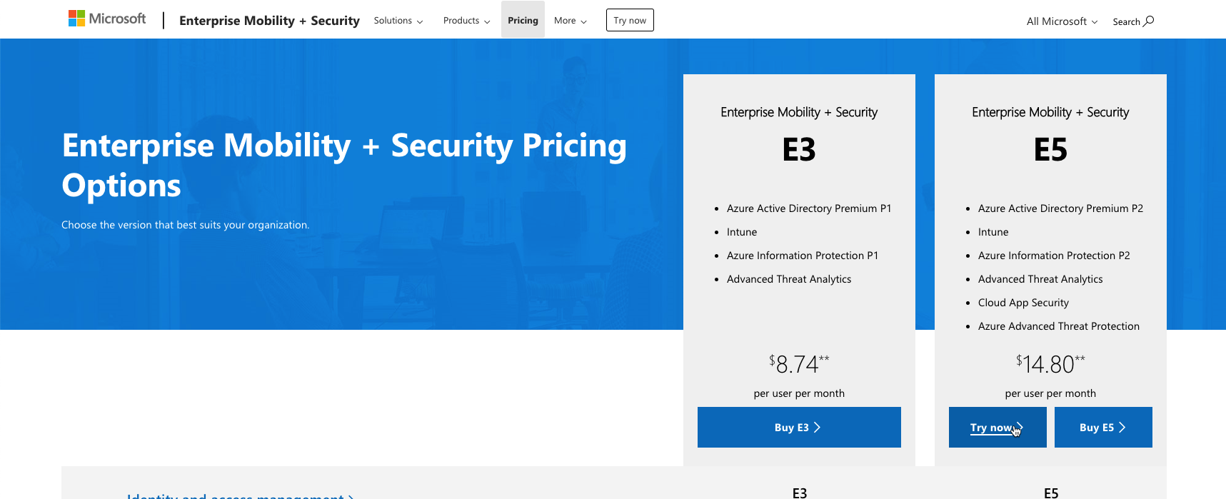
Add and Enterprise Mobility + Security Trial to your Office 365 E5
https://www.microsoft.com/en-us/cloud-platform/enterprise-mobility-security-pricing
Can only trial E5

Slide 23
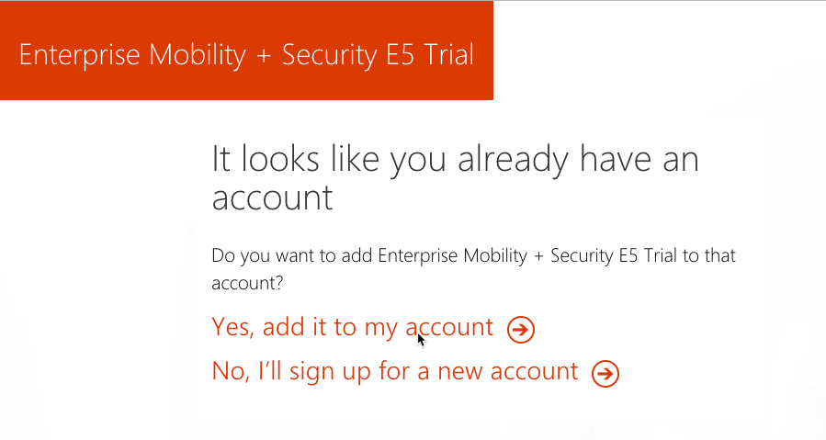
If you’re already signed in

Slide 24
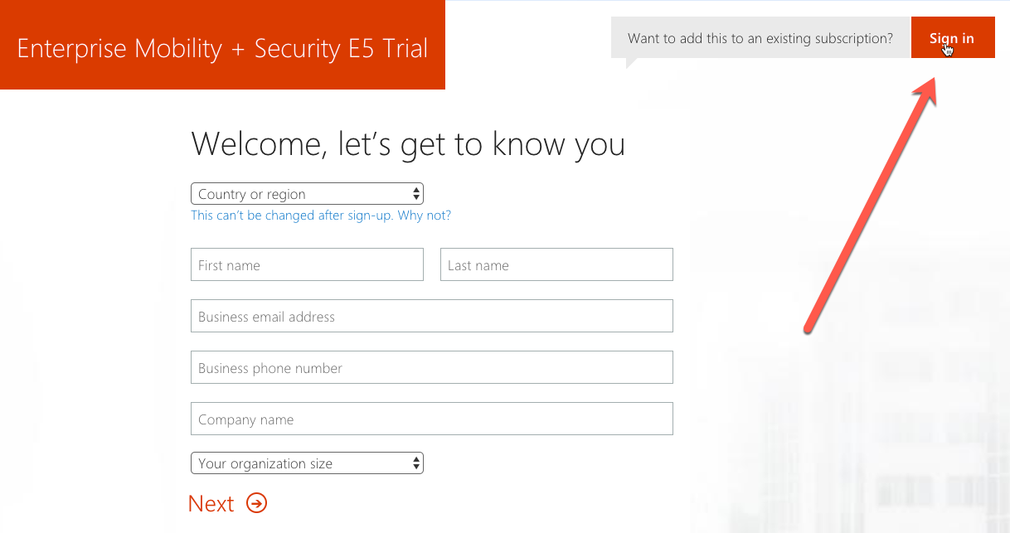
If you’re not signed in

Slide 25
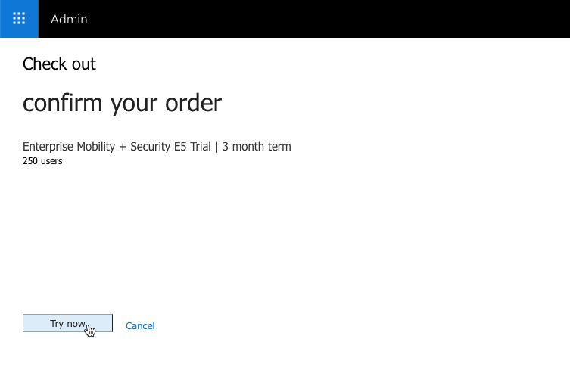
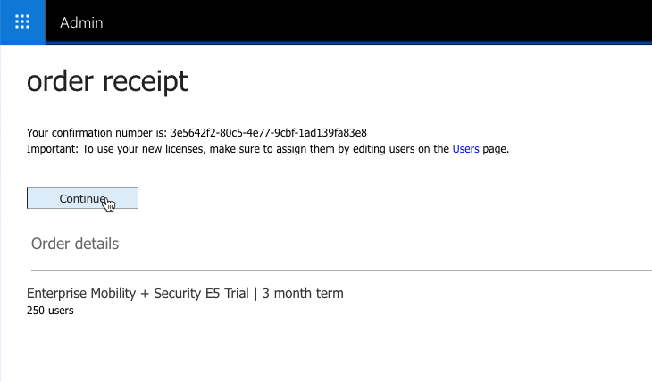
Add the trial

Slide 26
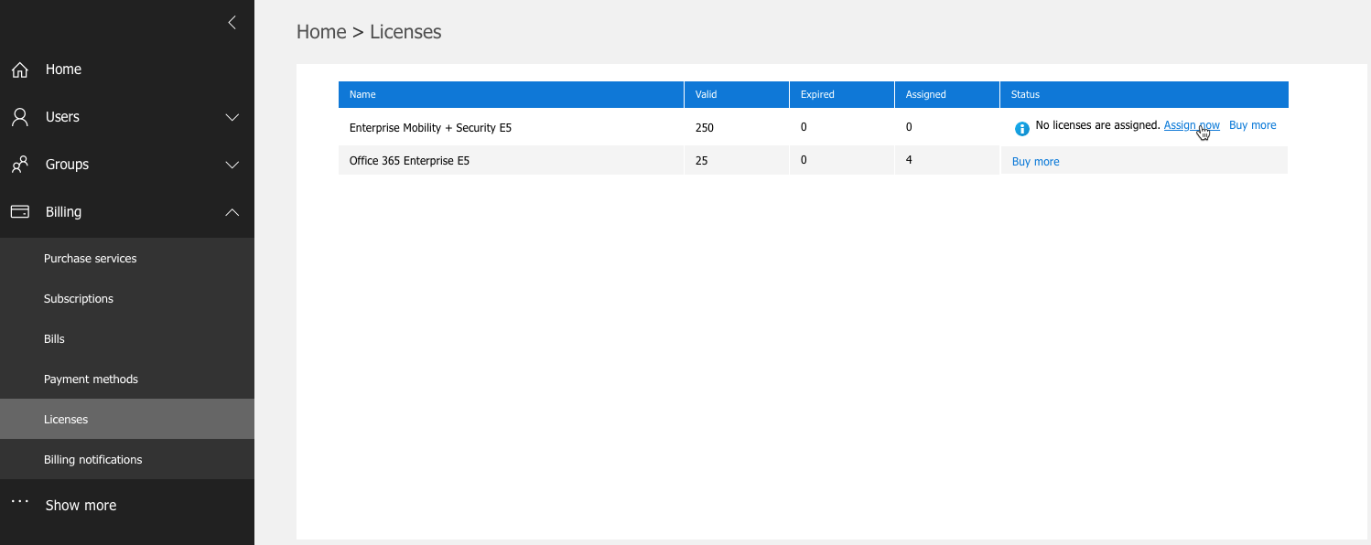
Verify and assign licenses

Slide 27
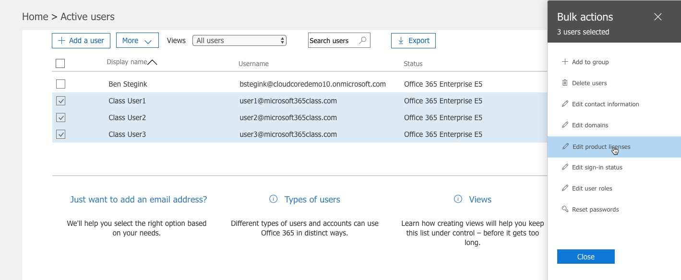
Assign licenses

Slide 28
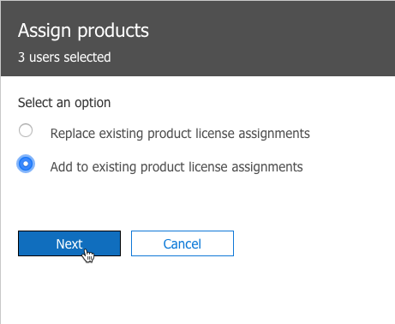
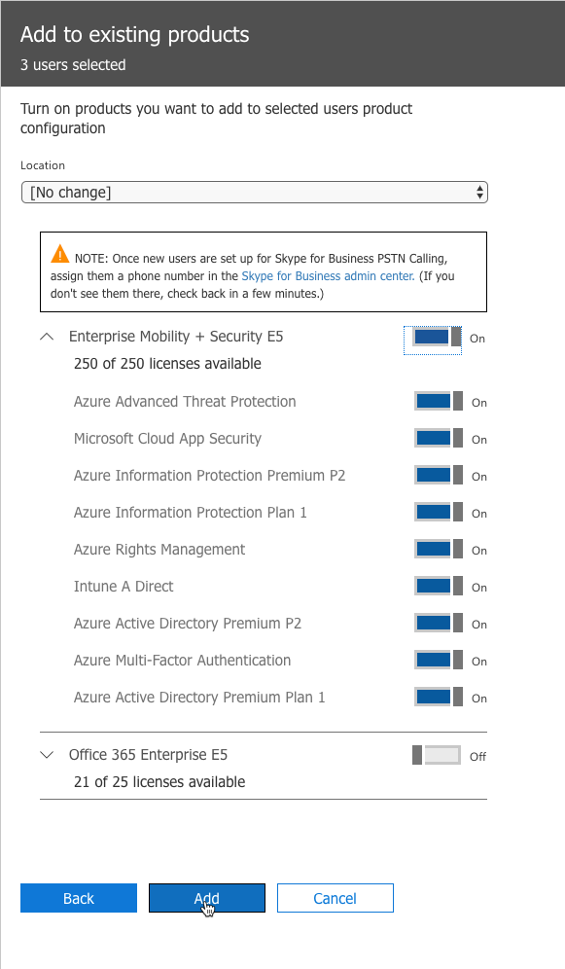
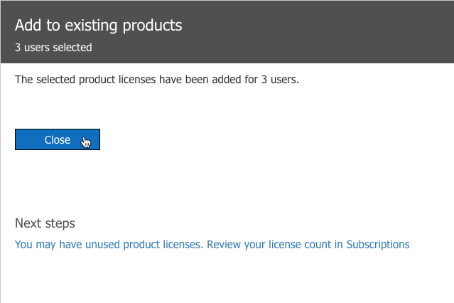
Assign licenses

Slide 29
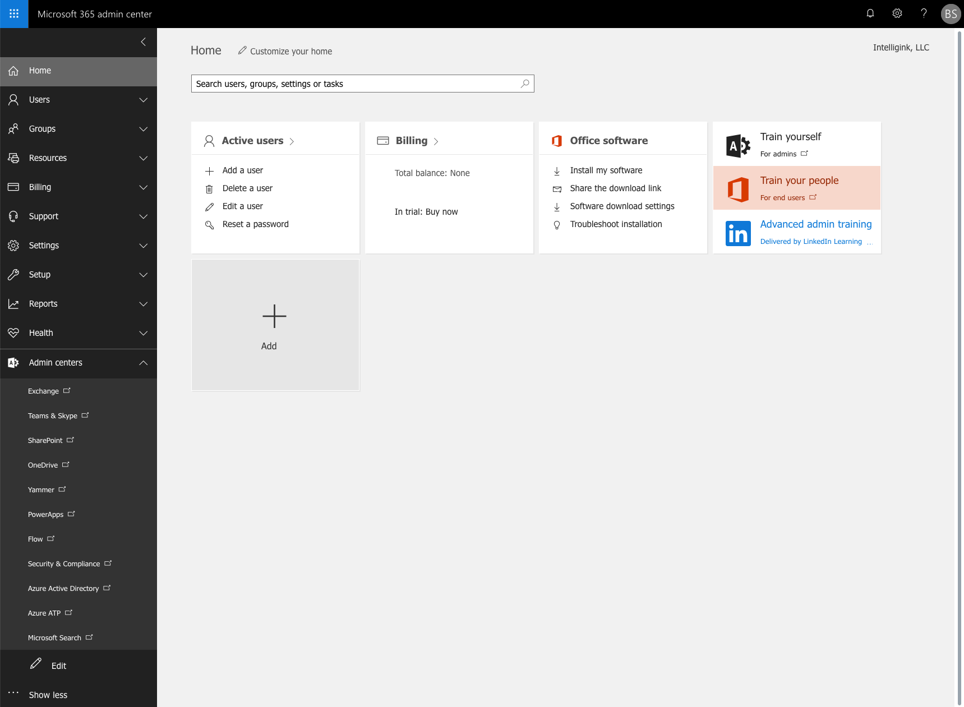
Your Office 365 E5 + Microsoft 365 E5 demo/trial tenant are ready to go!

Slide 30
Device Management
Microsoft Endpoint Manager

Slide 31


Management Powered by the M365 Cloud
 | On-premise
Traditional OS Deployment | 
Win32 app management | 
Configuration and GPO | 
Bitlocker Management | 
Hardware and software inventory | 
Update management | 
Cloud managed












Unified Endpoint Management – Windows, iOS, macOS, Android
Modern access control – Compliance, Conditional Access
Modern provisioning – Autopilot, DEP, Zero Touch, KME
Modern security – Hello, Attestation, ATP, Secure Score
Modern policy – Conditional Access, App Policies
Modern app management – O365 Pro Plus, Stores, SaaS, VPP
Full Microsoft 365 integration – Analytics, Graph, Console, RBAC, Audit

Slide 32

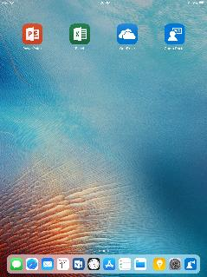
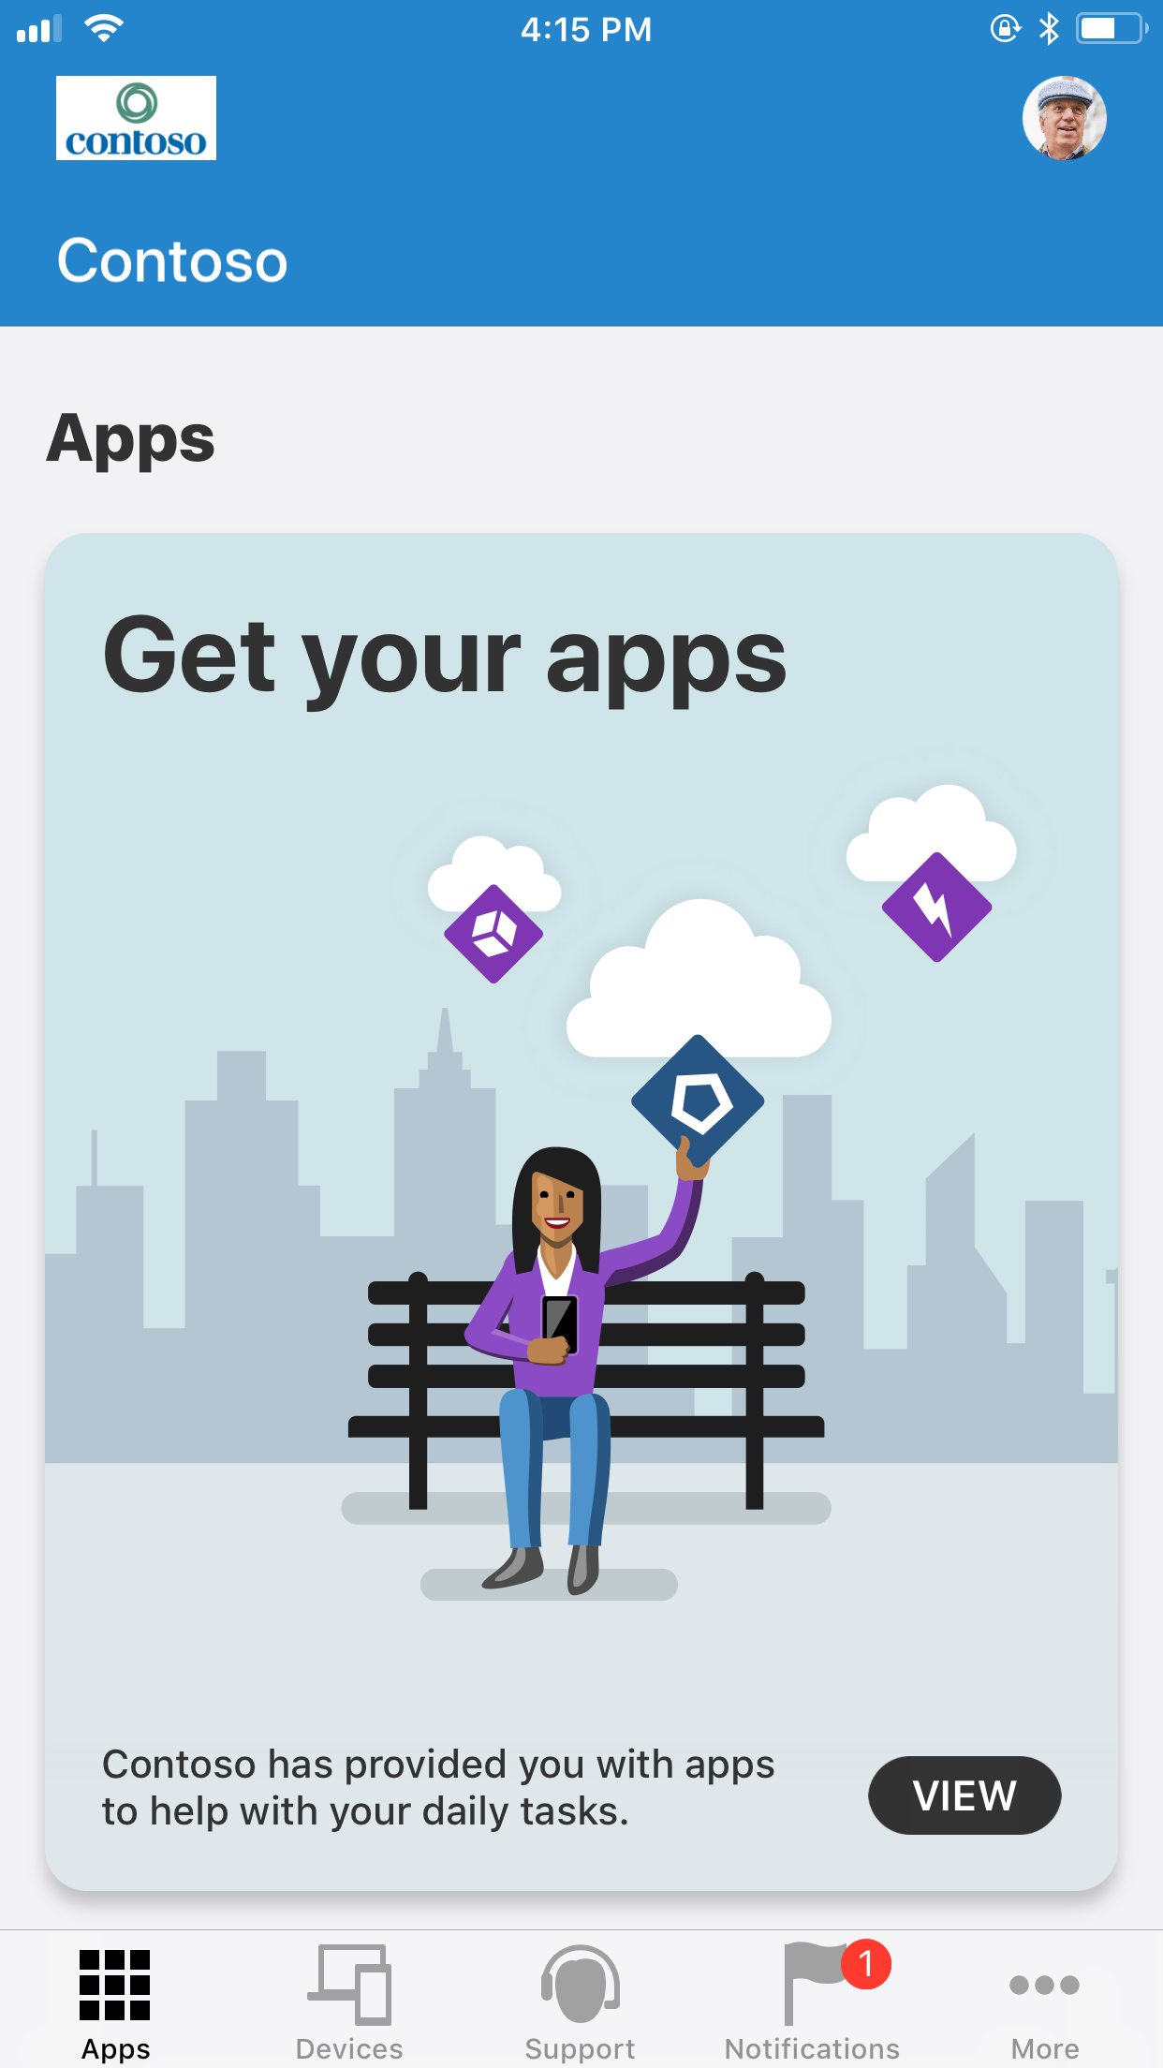
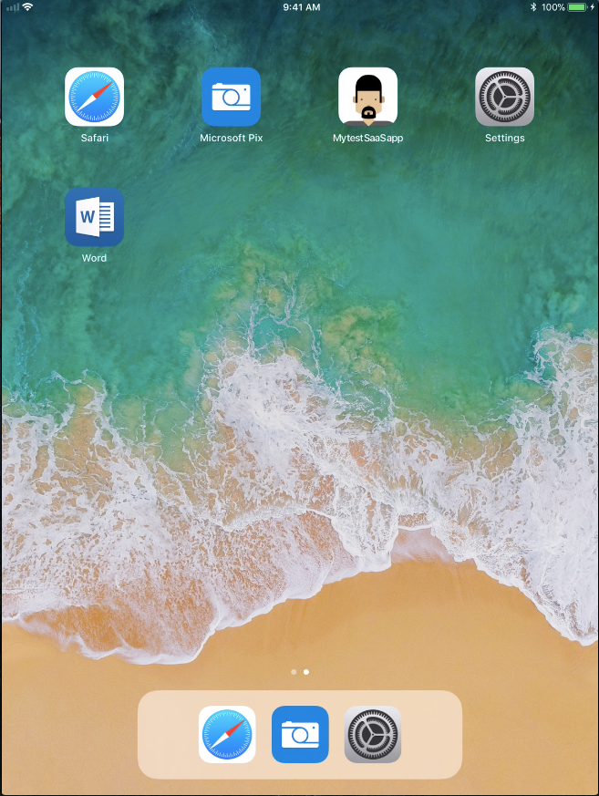

iOS deployment scenarios
BYOD
CORP OWNED
iOS app managed
iOS device managed
Data protection at the app level
App protection without full device management
User-based enrollment via Company Portal
Push Apps and policies
Device based Compliance
Apple Corporate programs like VPP, DEP, ASM
Supervised mode with for controls
Secure locked down devices: Kiosk, Classroom
Lock management profile to a device

Slide 33
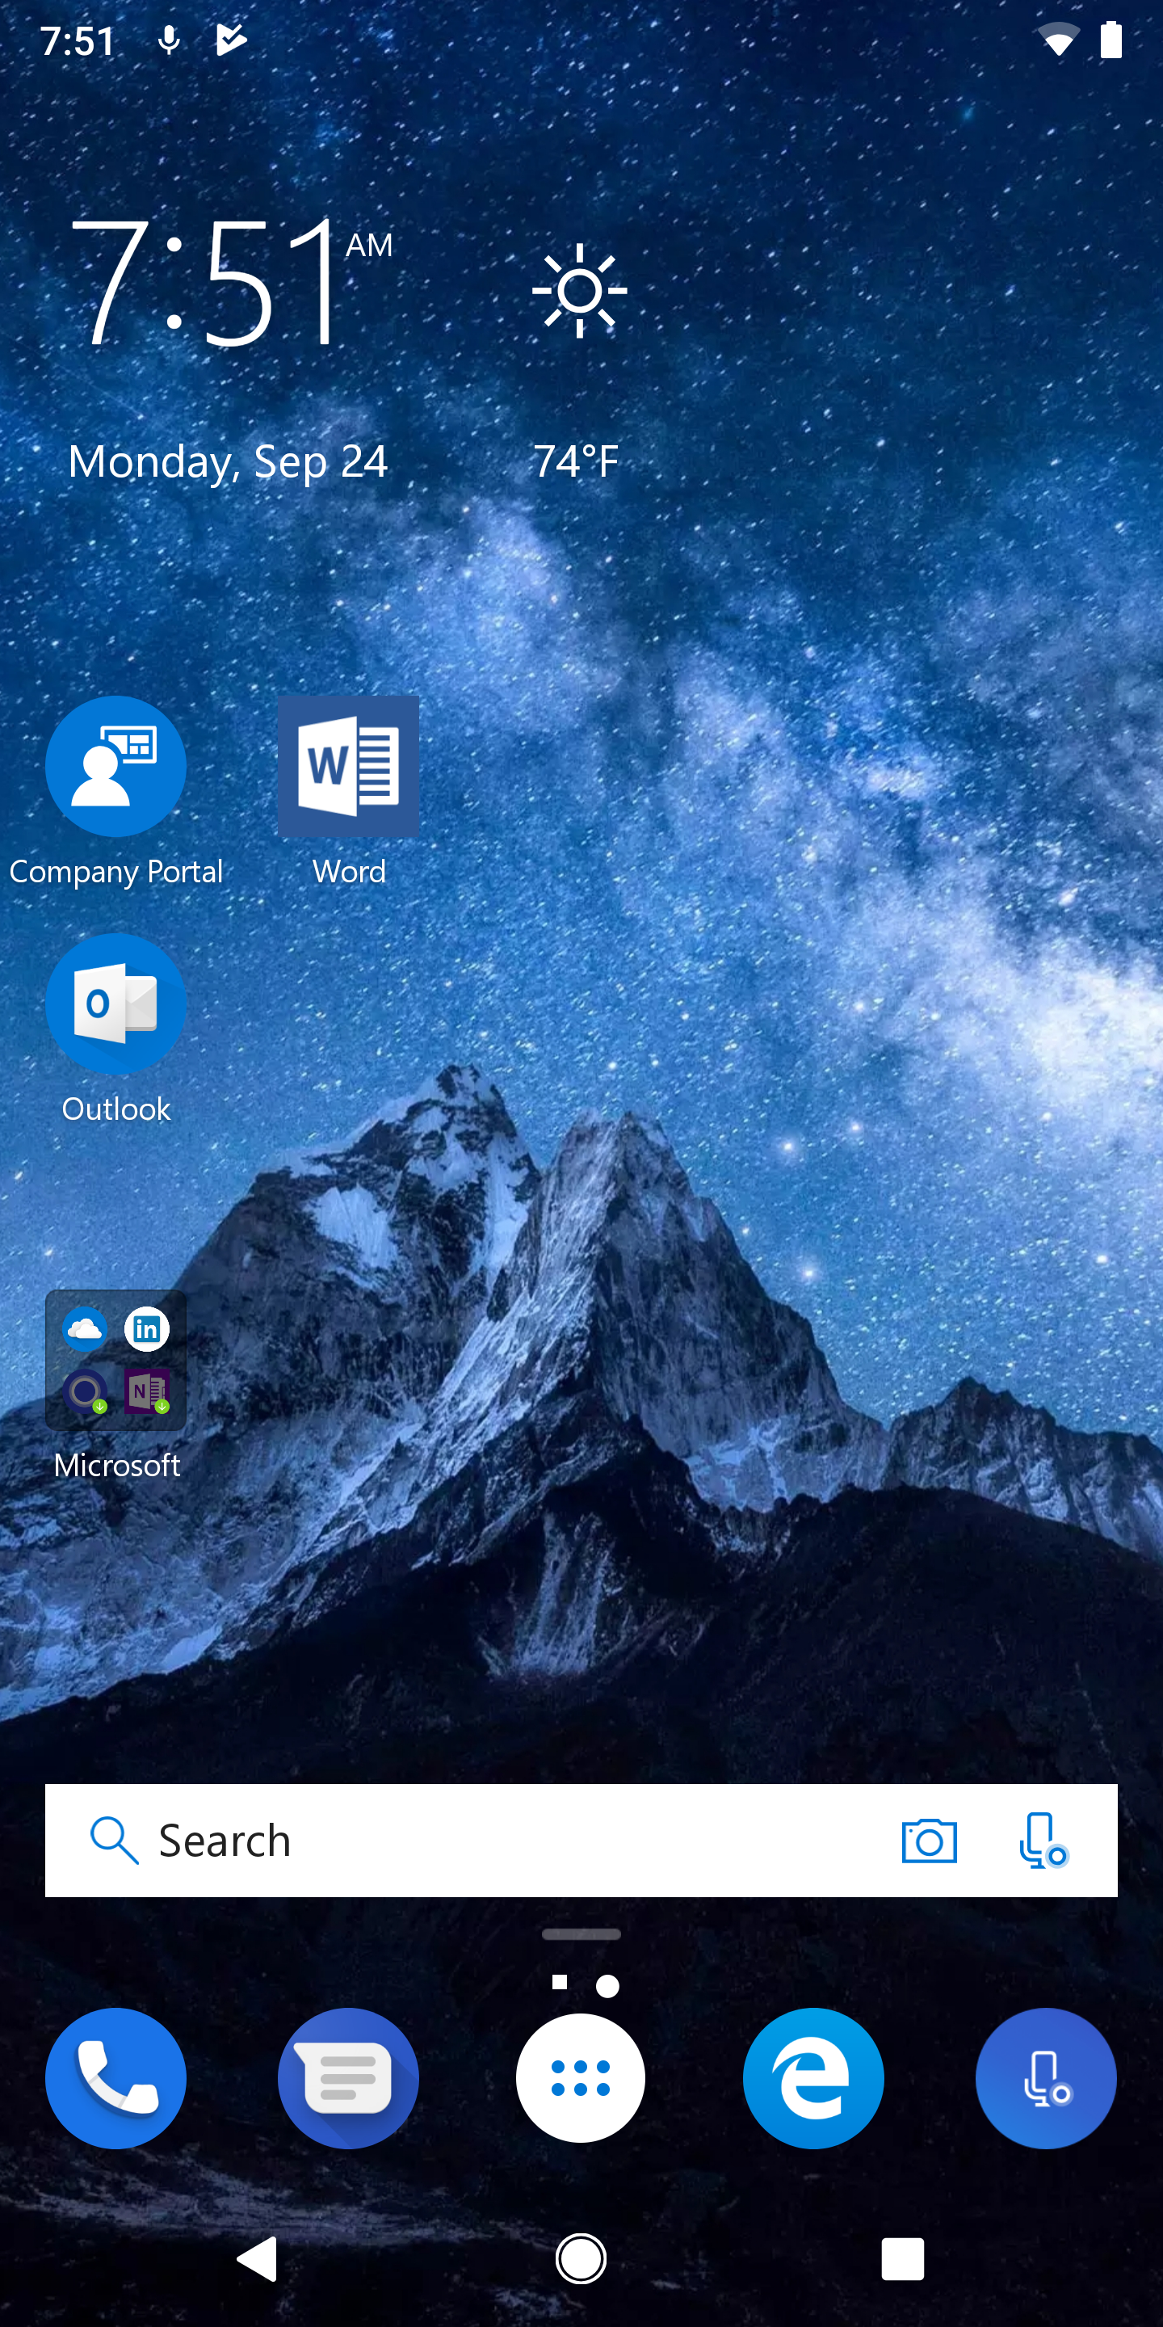
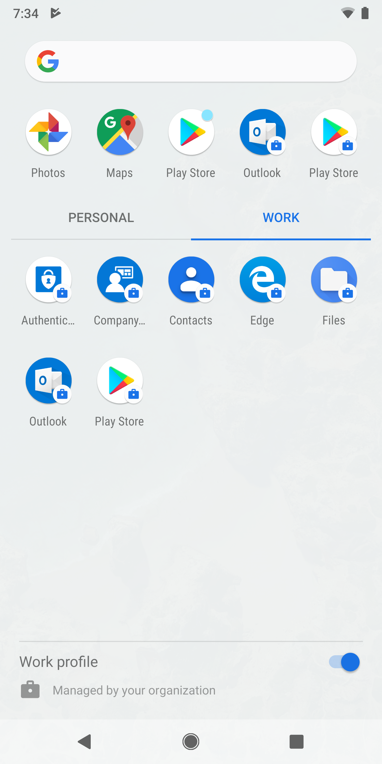
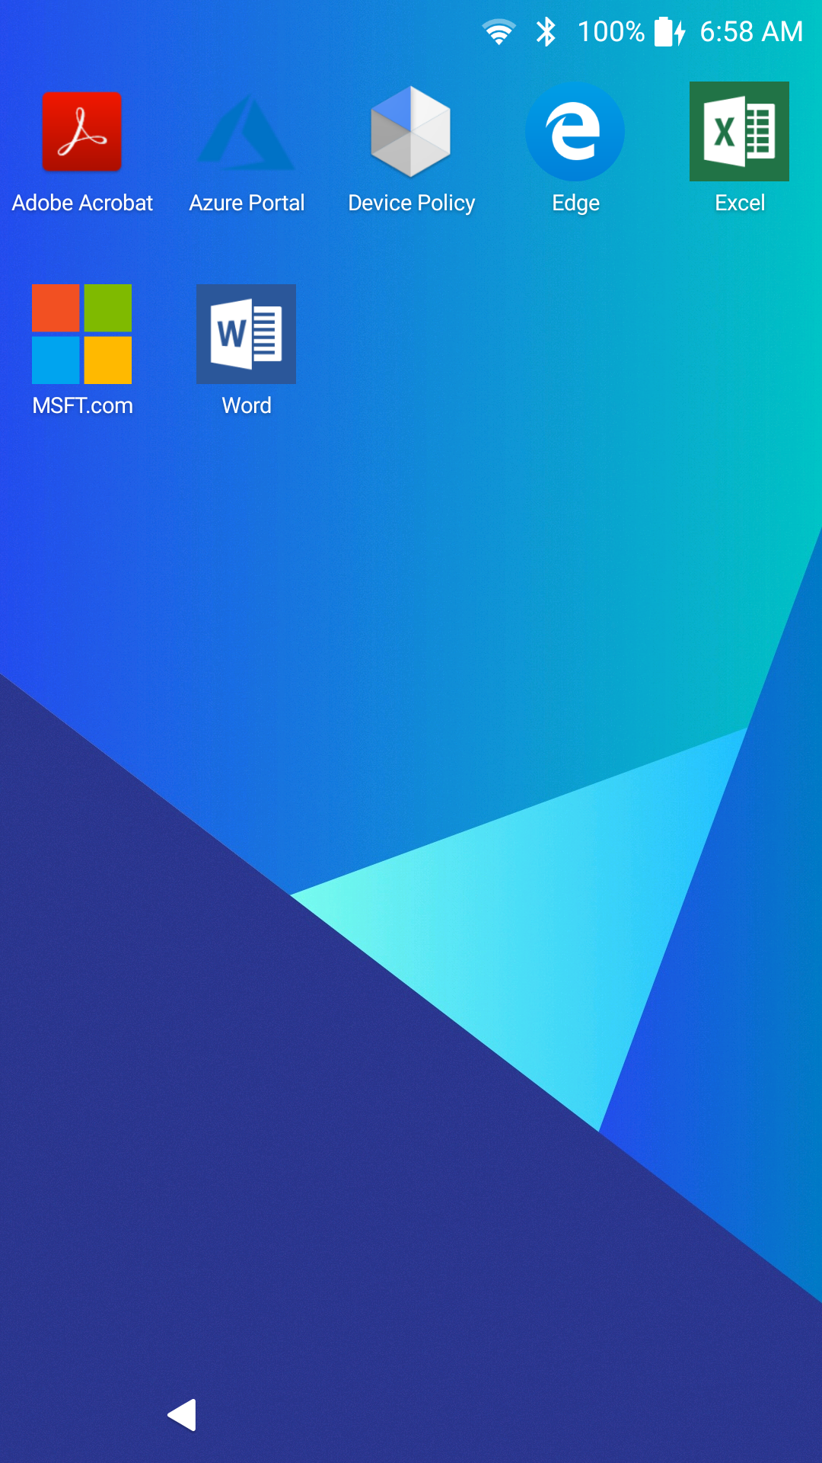
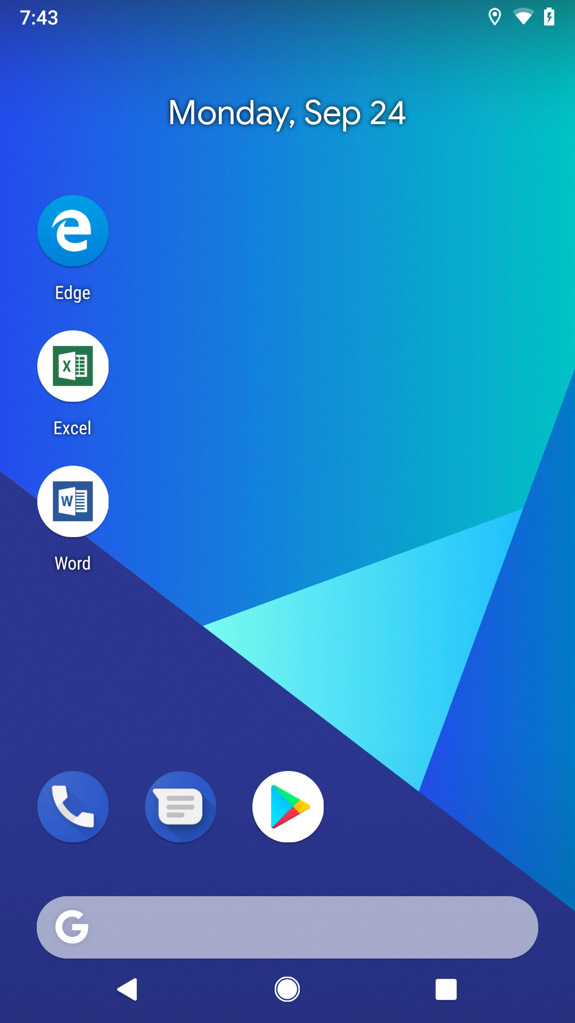
Android deployment scenarios
BYOD
Intune App Protection Without Enrollment
Corp Owned
AE Dedicated (kiosk)
AE Fully managed
AE Work Profile

Slide 34

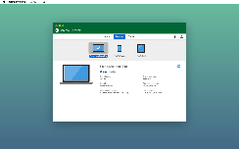


macOS deployment scenarios
- OR -
+ MEM
MEM/Intune managed
Jamf managed, Intune compliant
Basic platform MDM management. Ideal for:
Scoped/modern management needs for corp owned devices
Deploying certs, pw configuration, apps
Limiting access to compliant Macs
Protection with device wipe, encryption
Full application lifecycle management staring with Big Sur
MDM management. Ideal for:
Extensive inventory
Depth of security controls
Self Service app catalog & End user controls
Limiting access to compliant Macs
Scripting

Slide 35
Modern Provisioning
Windows Autopilot Service
MEM and AAD
Existing Devices
Register devices
Register devices, configure profiles
Self-deploy
Hardware Vendor
IT Admin
Ship
Deliver direct to Employee
Employee unboxes device, self-deploys

Slide 36
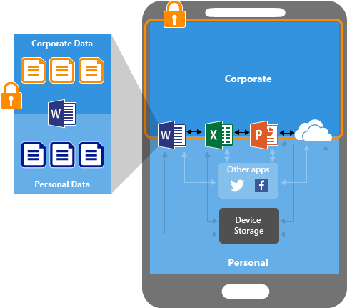
Why Microsoft Endpoint Manager (MEM) App Protection for mobile devices
Independent of mobile device management
Protecting data at app level
End-user productivity not affected
Separate work data from private data

Slide 37

Without Enrollment
Enables BYOD
Non-intrusive management
Full privacy
Works on all iOS and Android Devices
Corporate data secured
Notes:
Highlight on without enrollment

Slide 38



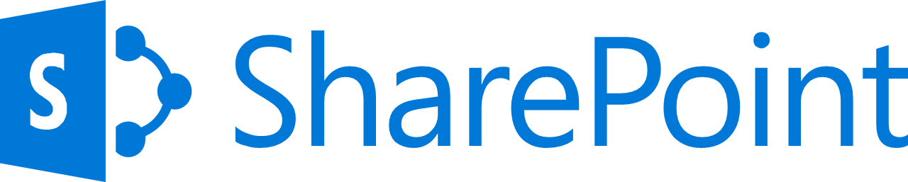
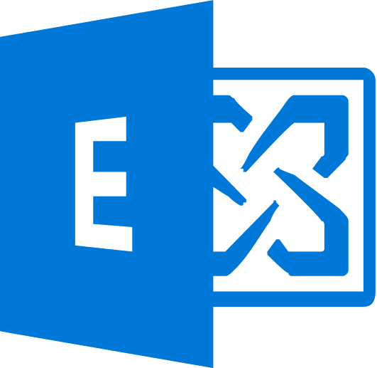



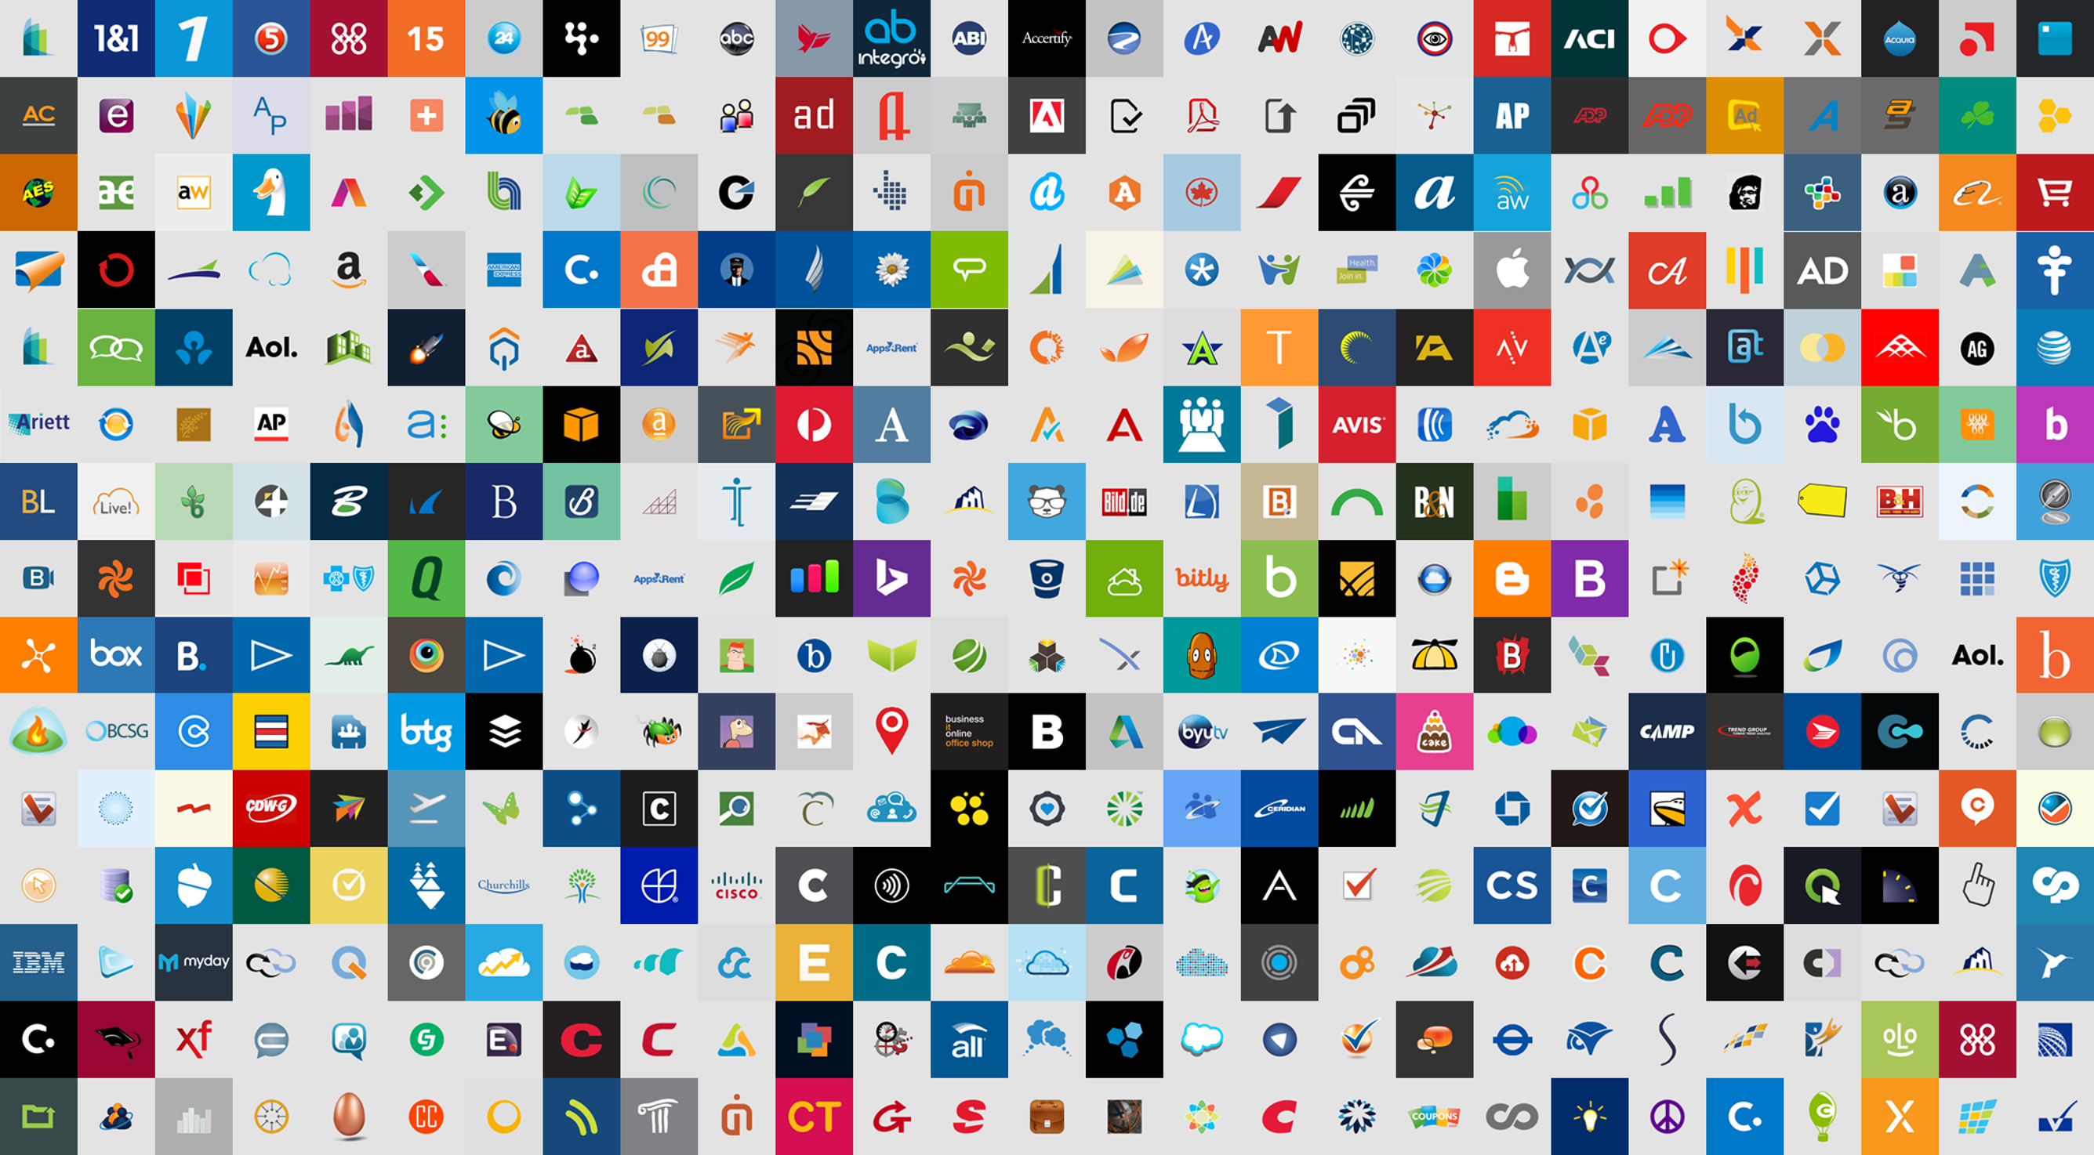


Conditional Access
Azure AD
ADFS
Conditions
Controls
MSA
40TB
Google ID
Employee & Partner Users and Roles
Allow/block
access
Microsoft Cloud
Android
Session Risk
iOS
Machine learning
3
MacOS
Trusted & Compliant Devices
Limited
access
Microsoft Cloud App Security
Windows
Microsoft Defender ATP
Real time Evaluation
Engine
Require
MFA
Cloud SaaS apps
Geo-location
Location
Force
password
reset
Corporate Network
******
Policies
Effective policy
Client apps & Auth Method
Terms of Use
Browser apps
Client apps
On-premises apps

Slide 39
Security and Compliance in Microsoft 365

Slide 40
Security for Services

Slide 41
Microsoft 365
Administrator Roles
Global Administrator
Specialized Admin Roles
Privileged Identity Management (PIM)
No standing admin access
Request/Approve elevated admin for a set time
Groups
Security Groups
Distribution Groups
Microsoft 365 Groups
Notes:
Customized Administrator Roles - https://docs.microsoft.com/en-US/microsoft-365/admin/add-users/about-admin-roles?WT.mc_id=365AdminCSH&view=o365-worldwide
PIM
- https://docs.microsoft.com/en-us/azure/active-directory/privileged-identity-management/
- https://docs.microsoft.com/en-us/azure/active-directory/privileged-identity-management/pim-configure

Slide 42
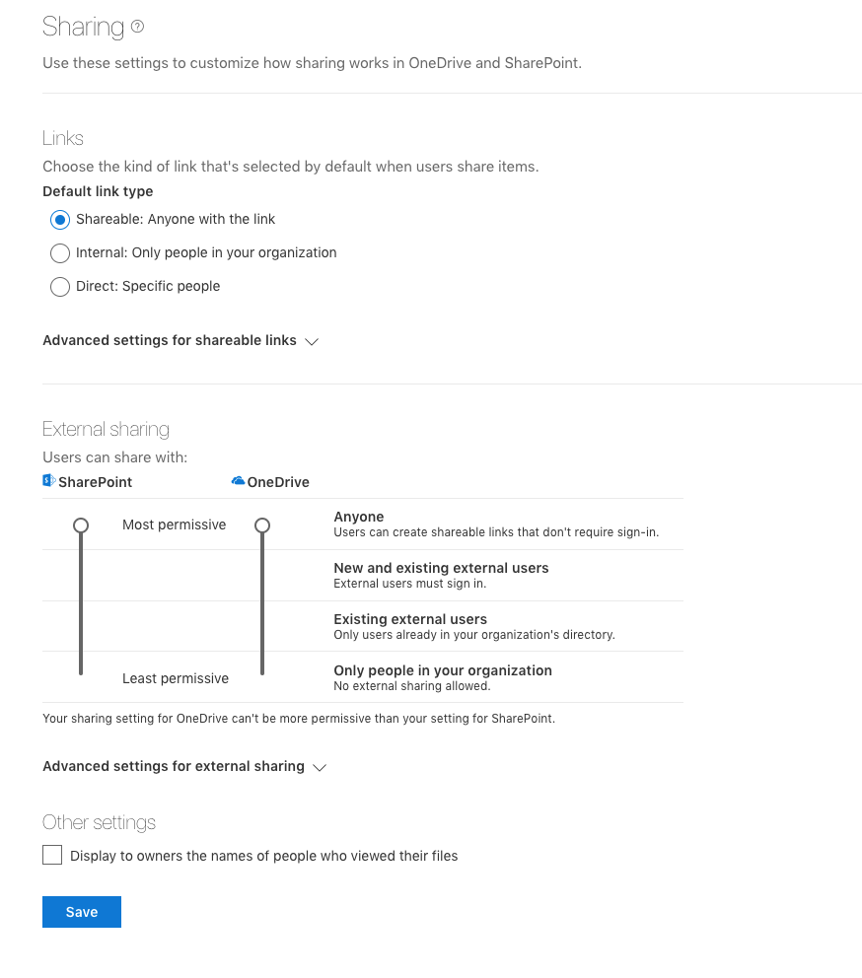
SharePoint
SharePoint Admin
Site Collection Admin
SharePoint Permissions
Owners
Editors
Viewers
Customize Permission Levels
External Sharing
Guest Access
Anonymous Access
Sharing Expiration

Slide 43
Exchange Online
Admin Roles
Role Based Access Control (RBAC)
User Roles
Control what Outlook options people have access to
Shared Mailboxes
Full Access
Send As
Mailbox Permissions
Full Access
Send As
Send on Behalf
Notes:
Exchange Online Permissions - https://docs.microsoft.com/en-us/exchange/permissions-exo/permissions-exo

Slide 44
Teams
Communication admin
Communication support engineer
Communication support specialist
Service admin
Security & Compliance Center
Role Based Permissions similar to Exchange
Several different aspects from auditing to eDiscovery
eDiscovery -> Legal
Auditing -> Security
Mail Flow -> Exchange

Slide 45
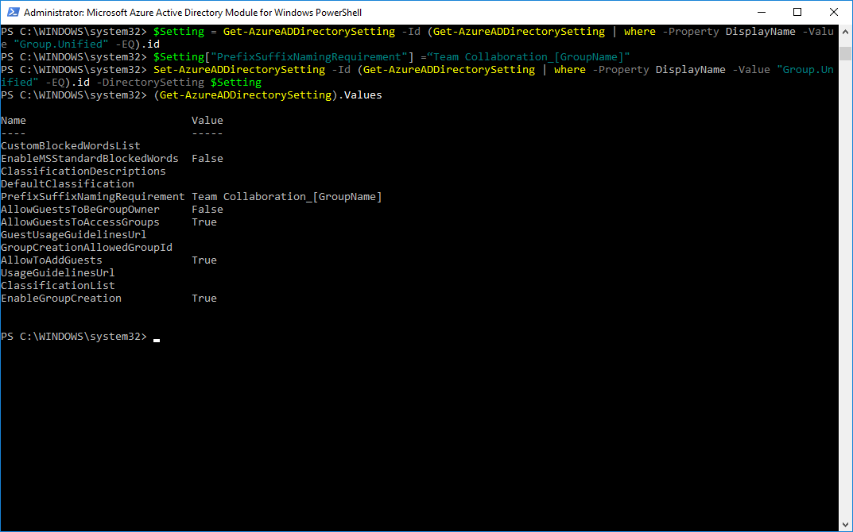
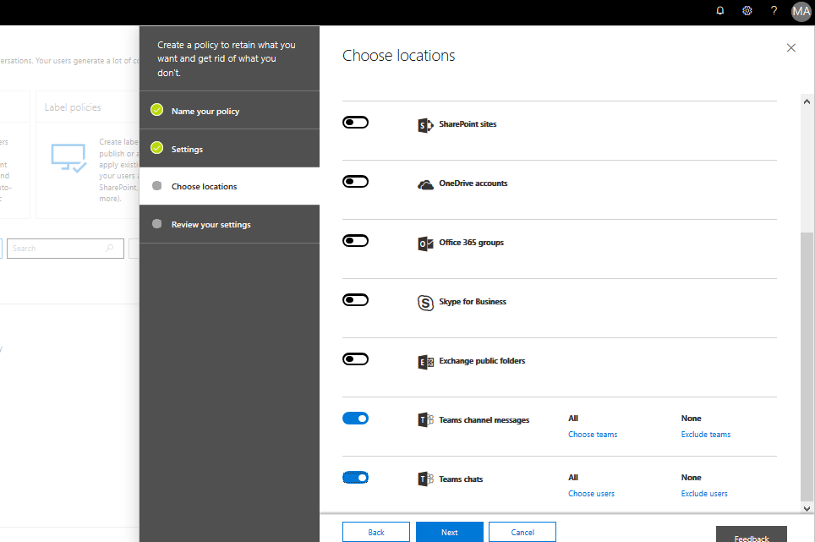
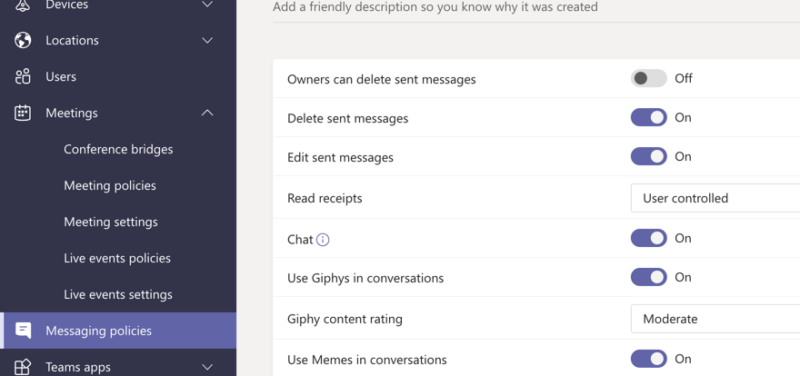
Set the controls your organization needs
M365 Core collaboration: Tenant policies for naming/expiry/guest access, conditional access
Communications: Policies and configurations for functions within Teams – like meetings/messaging/calling – https://admin.teams.microsoft.com/
Security & Compliance: Integrate Teams into your existing Security & Compliance policies – like retention and eDiscovery

Slide 46
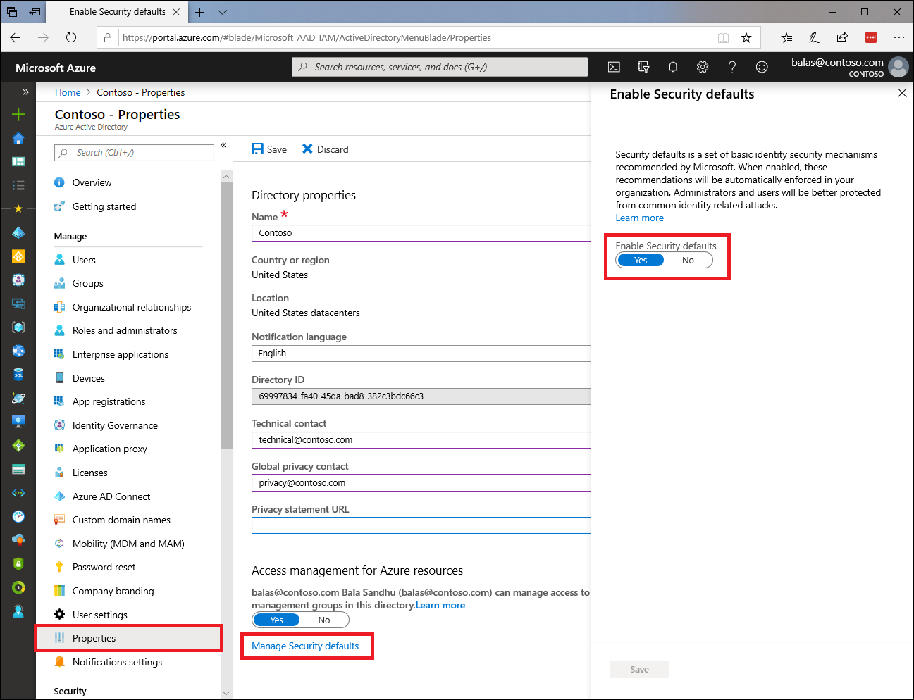
Security Defaults
Replaces baseline security policies
On by default
Requiring all users to register for Azure Multi-Factor Authentication.
Requiring administrators to perform multi-factor authentication.
Blocking legacy authentication
Protecting privileged activities like access to the Azure portal & CLI
ONLY the Microsoft Authenticator app
Notes:
https://docs.microsoft.com/en-us/azure/active-directory/fundamentals/concept-fundamentals-security-defaults

Slide 47
Multi-Geo in Office 365

Slide 48
SharePoint and OneDrive
Enables compliance with data sovereignty laws
Not performance optimization
Supports multi-geo within on tenant
Allowed Data Locations (ADL)
Preferred Data Location (PDL)
Enable multi-geo
Currently only through your Office 365 account team
Select ADL for your tenant
PDL is on a user-by-user basis
Migrate a users OD4B if required

Slide 49
Exchange Online
Just like SharePoint a geo is user-by-user
Location of the Exchange Online mailbox content
Default is based on the Office 365 tenant billing address
Create or Move mailboxes into a specific geo
Setup by account team and ordering the license
Limitations
Only supports user mailboxes, resources mailboxes and shared mailboxes
Mailboxes can’t be shared across geos in Outlook on the web
Notes:
Customized Administrator Roles - https://support.office.com/en-us/article/About-Office-365-admin-roles-da585eea-f576-4f55-a1e0-87090b6aaa9d
Baseline protection - https://docs.microsoft.com/en-us/azure/active-directory/conditional-access/baseline-protection
PIM
- https://docs.microsoft.com/en-us/azure/active-directory/privileged-identity-management/
- https://docs.microsoft.com/en-us/azure/active-directory/privileged-identity-management/pim-configure

Slide 50
Security & Compliance

Slide 51
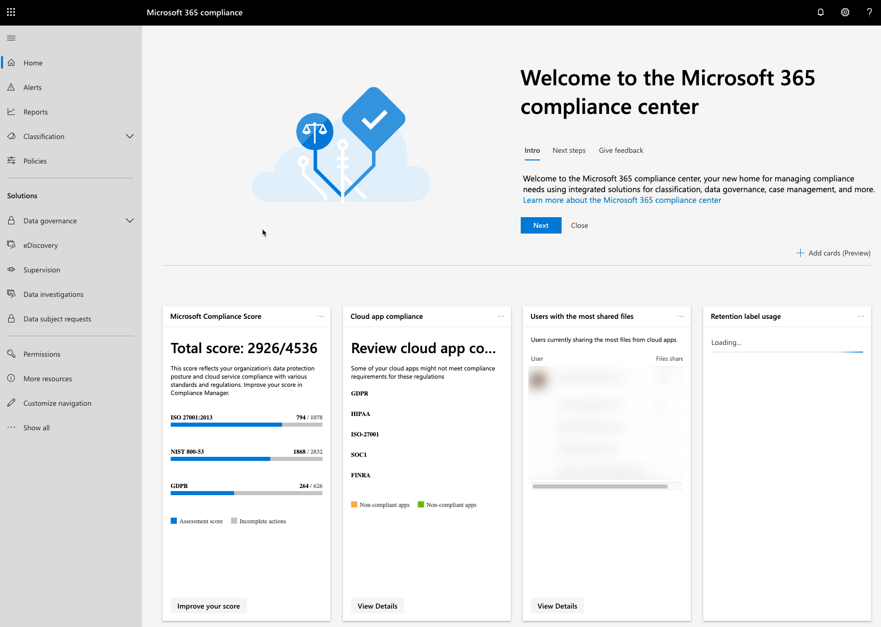
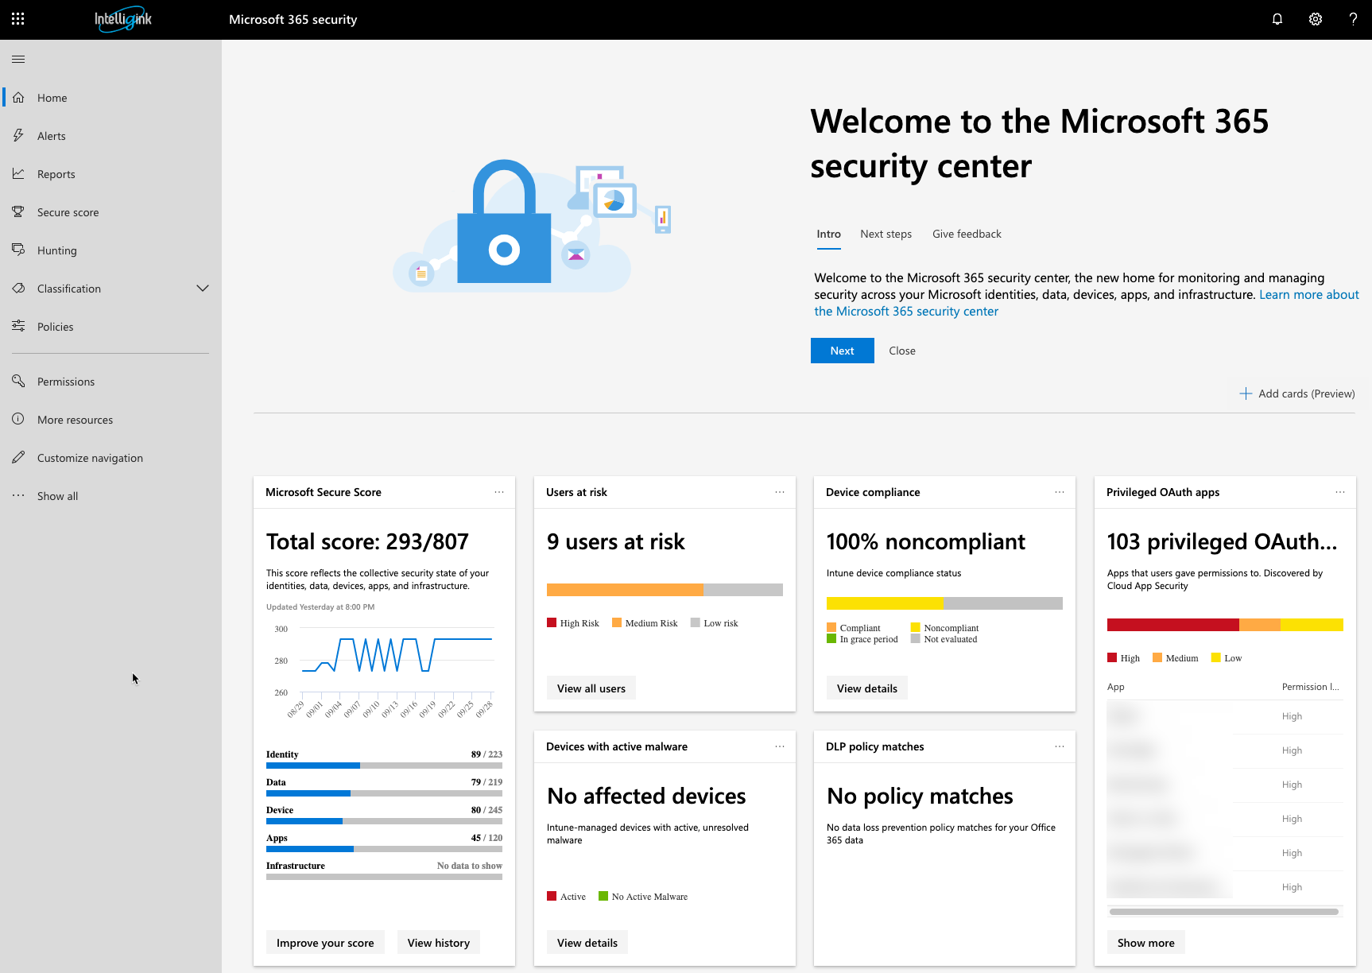
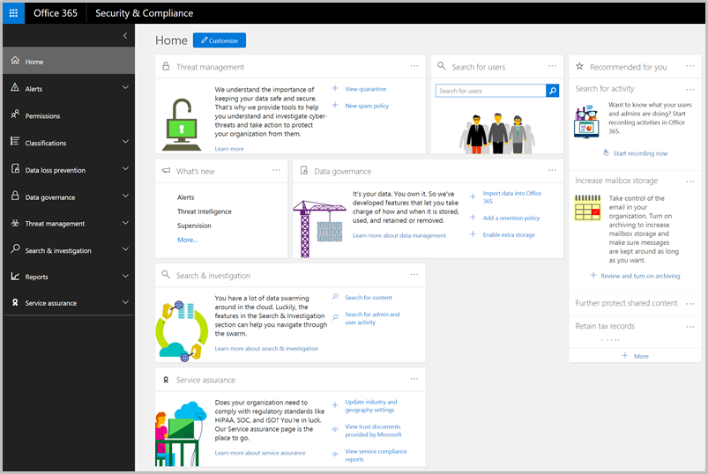
Security, Compliance, Security & Compliance
Security Center
https://security.microsoft.com/
Compliance Center
https://compliance.microsoft.com/
Security & Compliance Center (Legacy)
Will be retired
https://protection.office.com/

Slide 52

How can the Security & Compliance Centers Help?
Alerts – Users Performing specific actions
Data Classification – Retention labels and sensitive information types
Data loss prevention (DLP) – sensitive information policies
Communication compliance – Minimize communication risks
Data governance – Activity, Import, Retention, Archive
Threat management – Mail, Attacks, EOP Policies

Slide 53
How can the Security & Compliance Centers Help? (cont.)
Mail flow – Suspicious mail flow and message trace
Data privacy - GDPR
Search & investigation – Audit logs, content search, eDiscovery
Reports – Labels, Mail Security, DLP
Service assurance – Certification Compliance reports, Trust documents, standards and regulations

Slide 54
Trust Center
Notes:
https://docs.microsoft.com/en-us/office365/enterprise/azure-expressroute

Slide 55
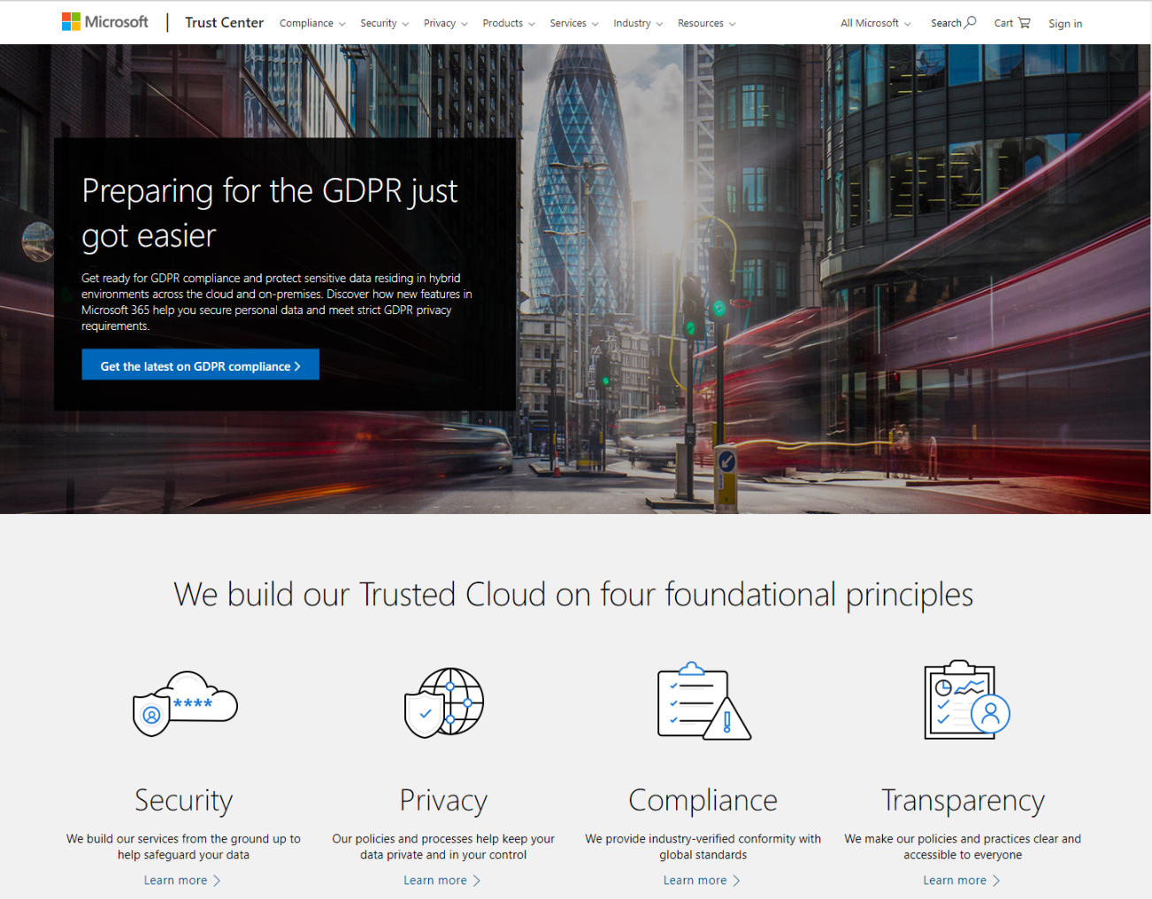
Microsoft Trust Center
Microsoft Trust Center is your resource for learning how Microsoft implements and support security, privacy, compliance, transparency in its cloud products and services. The Trust Center is an important part of the Microsoft Trusted Cloud initiative and provides support and resources for the legal and compliance community.
In-depth information about security, privacy, and compliance offerings, policies, features, and practices across Microsoft cloud products.
Recommended resources, a curated list of the most applicable and widely-used resources for each topic.
Information specific to key organizational roles, including business managers, tenant admins or data security teams, risk assessment and privacy officers, and legal compliance teams.
Direct guidance and support, including options for contacting Microsoft in the Contact Trust Center section of the overview page.
http://www.microsoft.com/TrustCenter

Slide 56
Protect your information

Slide 57





How does EMS help protect information?
Persistent data protection
Protection based on classification
Encryption, Restrictions, Watermarks
Artificial Intelligence (AI) driven data classification and labeling
Discovery sensitive information: Cloud Apps and On-Premises file servers
Classification based on discovery or manually classified
Document tracking and revocation
Reporting on policy violations
Encryption key management
External user collaboration: securely share content with external users
B2B Collaboration

Slide 58
Review
Microsoft 365 F1
Microsoft 365 E3
Microsoft 365 E5
Windows Enterprise
Office Web Applications
Office 365 F1
EMS E3
Windows Enterprise
Office (Web & Desktop)
Office 365 E3
EMS E3
Windows Enterprise
Office (Web & Desktop)
Office 365 E5
EMS E5
No Trials of Microsoft 365, to simulate you can use Office 365 E3/E5 + EMS E3/E5 Trial
Need to go through Microsoft Sales or a CSP to get Microsoft 365 Licenses
Notes:
https://www.microsoft.com/en-us/microsoft-365/compare-all-microsoft-365-plans

Slide 59




Overview
Taking Security & Compliance to the next level
Control identity + access in the cloud
Get identity-driven security
Manage devices + apps
Protect your information

Slide 60
Control identity + access in the cloud

Slide 61
How does EMS help security identities and access?
Single sign-on: one username, one password
To all Office 365 Services
To additional third-party applications in the cloud or on-premises
Conditional access: restrict who can access what, from where, and on which device/platform
Restrict access by location/IP address
Limit what apps can be accessed
Control what clients can connect to Office 365 services
Access reviews: detect potentially compromised user identities
Conditional access based on sign-in risk level
Advanced security reporting
Privileged identity management
Secure Logins: more than just a username and complex password
Multi-Factor Authentication
Password-less authentication
External user collaboration: securely share content with external users
B2B Collaboration

Slide 62
Get identity-driven security

Slide 63



How does EMS protects against threats
Advanced Threat Analytics
Deployed on-premises to protect AD
Detect security breaches right away
Review timeline of the security breach
Advanced Threat Protection
Azure Advanced Threat Protection (ATP)
On-premises detection, cloud analysis and reporting
Windows Defender Advanced Threat Protection (Windows Defender ATP)
Desktop Protection
Office 365 Advanced Threat Protection (Office 365 ATP)
Email and cloud storage protection
Cloud App Security
Shadow IT: cloud discovery snapshot report
Protect information: activity log, approve/deny app permissions
Cyberthreats: Security configuration reports
Compliance: risk factors, regulatory
Notes:
Advanced Threat Protection - http://blog.goptg.com/microsoft-advanced-threat-analytics-vs.-advanced-threat-protection-whats-the-difference

Slide 64
Manage devices + apps

Slide 65


How does EMS help managing devices and apps?
Mobile Device Management (MDM)
Enroll device in Intune
Completely control over devices
Primarily corporate own devices
Mobile Application Management (MAM)
Control limited to mobile application
Protect the corporate data in the app, leave the personal data alone
Exchange, OneDrive
Bring Your Own Device (BYOD) scenario
Windows 10 Management
Auto-Pilot
MDM or MAM

